Slide 1

ENTERPRISE SOFTWARE DEVELOPMENT
Notes:
if possible, SQL Server Management Studio should be 25% bigger

Slide 2

Top Database Performance Techniques
.Net User Group August 2024

Slide 3
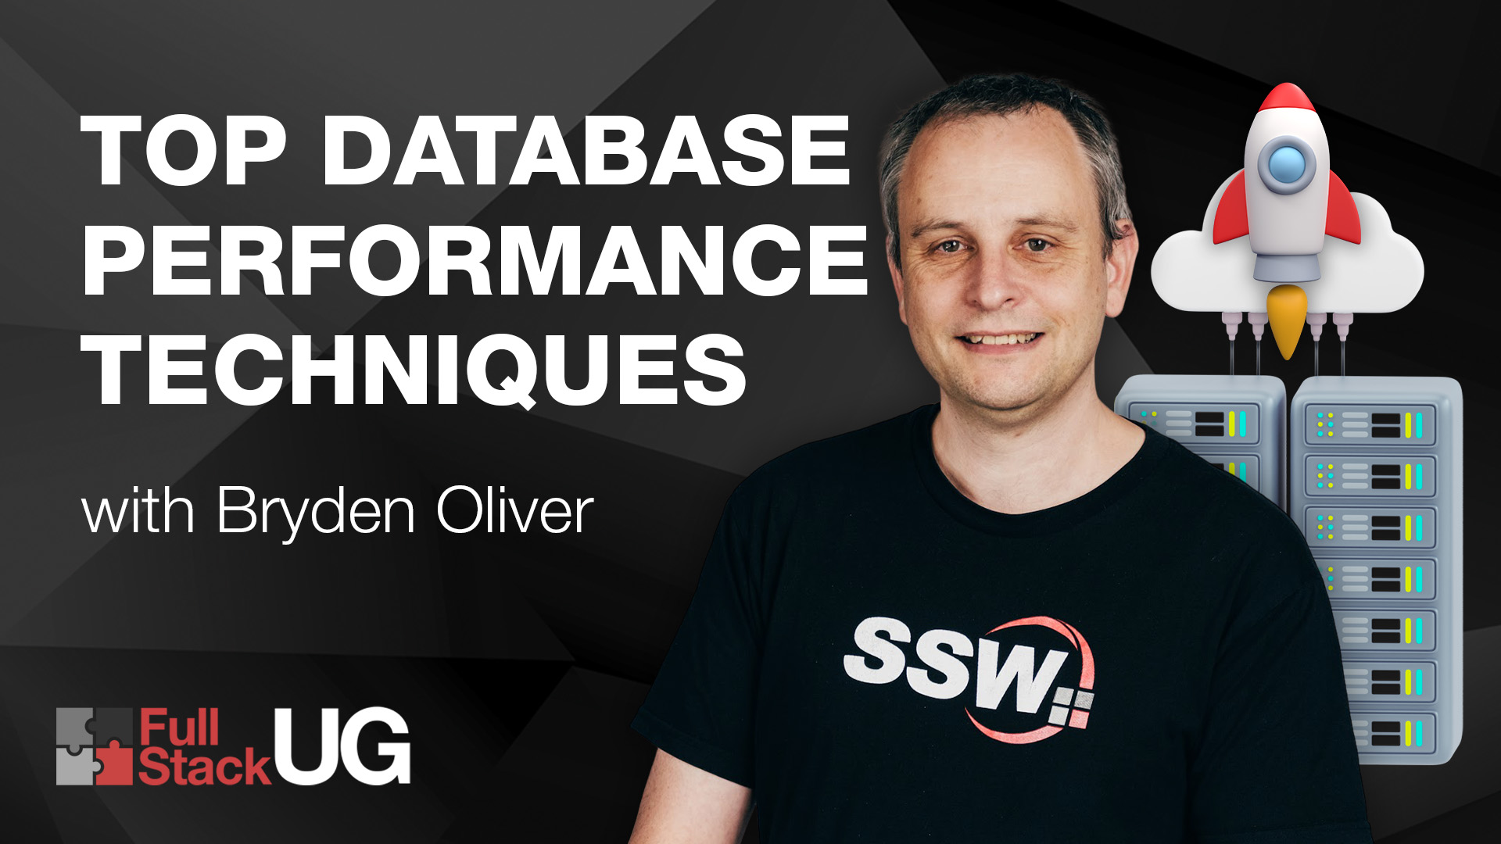

Slide 4



Bryden Oliver
SSW Solution Architect
linkedin.com/in/brydenoliver
github.com/brydeno
20 years experience in database performance
42 years of coding
Worked with Azure since its launch
Knows about Azure at scale

Slide 5

Find the presentation and demos at github.com/brydeno/DatabasePerformance
Notes:
We’ll cover lots of ground
Whole presentation is in GitHub
Demos are too

Slide 6

What are we covering
Improving query performance
Lots of demos
Simple techniques
Where possible, we’ll measure the improvement

Slide 7
Useful Tricks
It’s always useful when running locally to get query statistics
Run SET STATISTICS IO ON;
Before you run your query
We’ll see this in the demos ☺
There’s loads more little things littered through the demos

Slide 8
Example database
StackOverflow 2013 database

Slide 9
1. Reduce Table Size
WHY?
Large tables take longer to read and update
They take up more buffer space

Slide 10
1. Reduce Table Size
WHAT TO DO?
Archive unneeded data
Reduce column sizes
Remove unnecessary columns

Slide 11
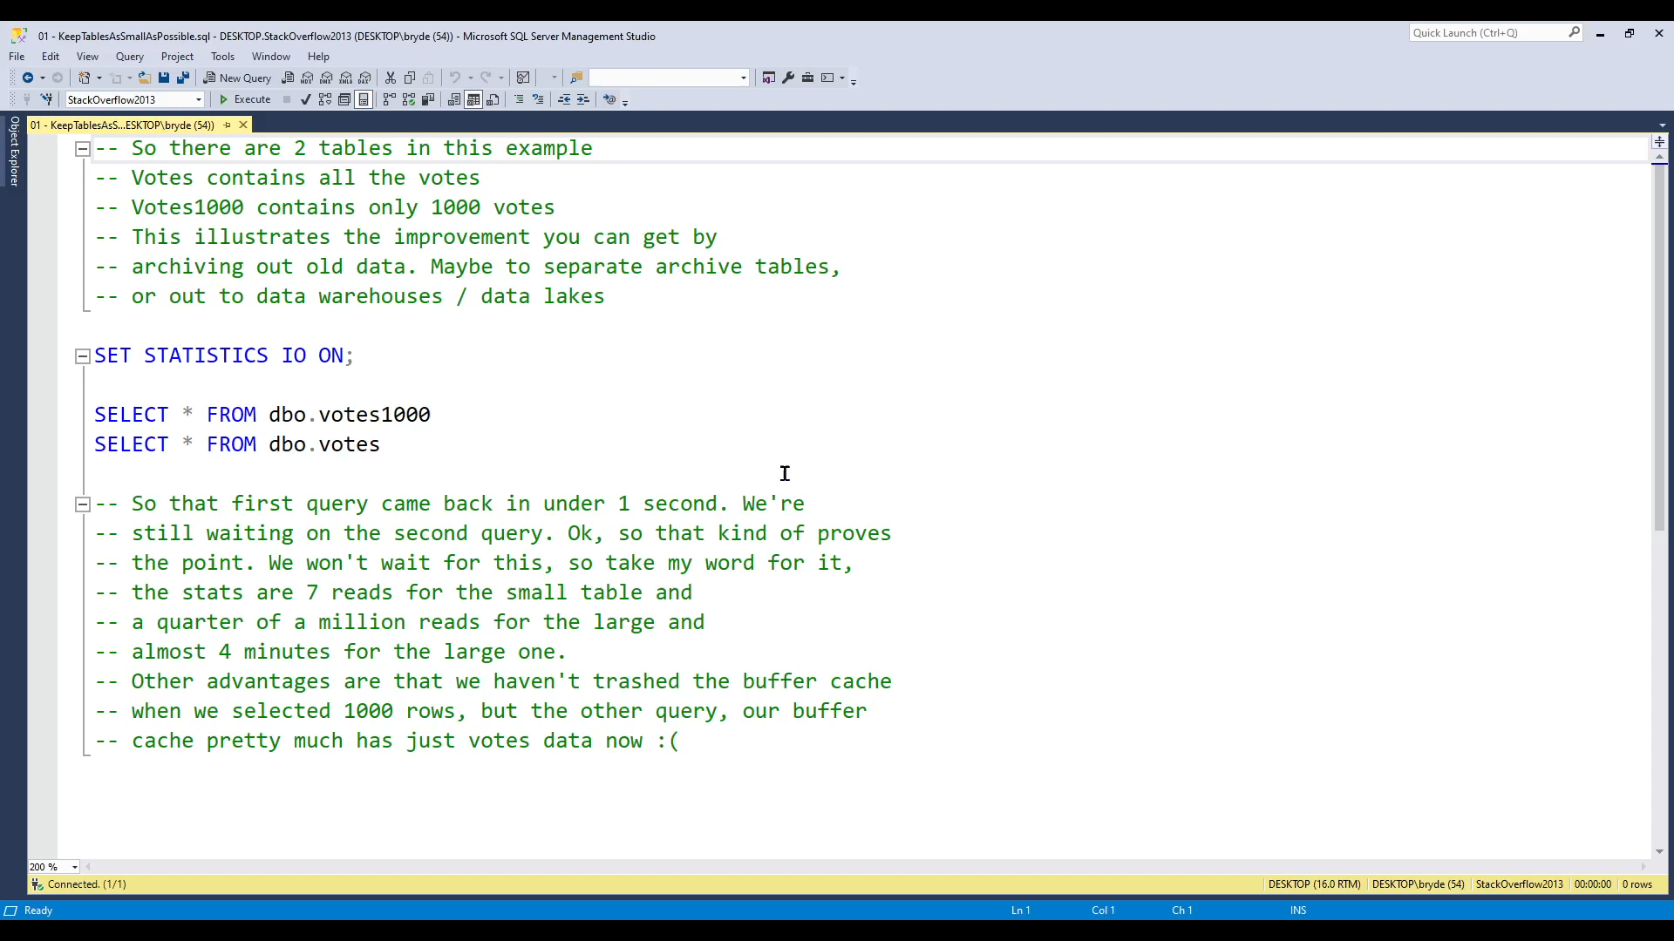

Slide 12
2. Use SELECT <fields> FROM rather than SELECT * FROM
Retrieving all columns can cause both index and table to be read
Takes more network to transmit
More CPU work at both ends

Slide 13
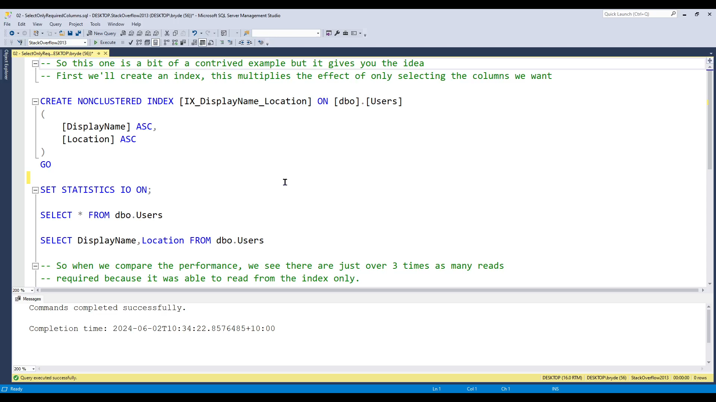

Slide 14
3. Create indexes
Generally gets the biggest wins
Takes some effort
Can make more than 1,000,000 times improvements
github.com/brydeno/DatabasePerformance

Slide 15
4. Verify indexes are being used
(Check for unused indexes)
You’d be surprised how often they aren’t
Run your query with “Show Actual Execution Plan” on
Check the plan is what you expect (or better)

Slide 16
DEMO
Execution plan
Unused index query

Slide 17
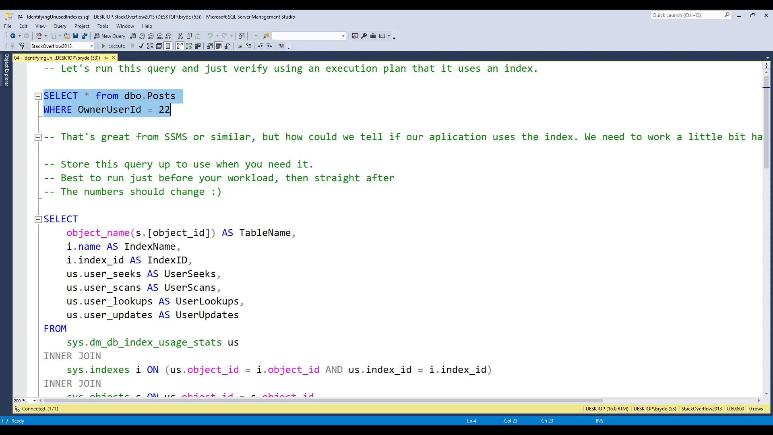

Slide 18
5. Avoid Implicit conversions
Make sure the type in WHERE clause matches column
Can make SQL Server scan a whole index 😱

Slide 19
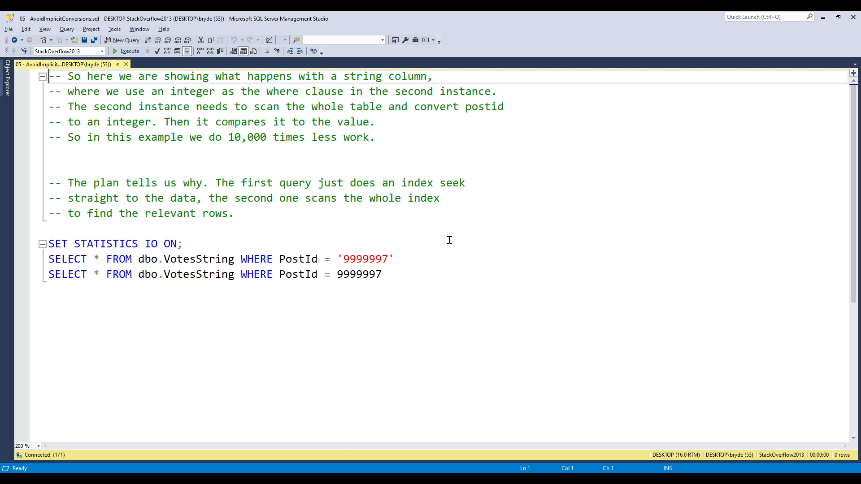

Slide 20
6. Avoid Looping
Looping causes the server to execute one after another
If you can get it to do in parallel much better
Often GROUP BY or aggregation a better choice
There are times looping is necessary
Looping database statistics is one (very few others)

Slide 21
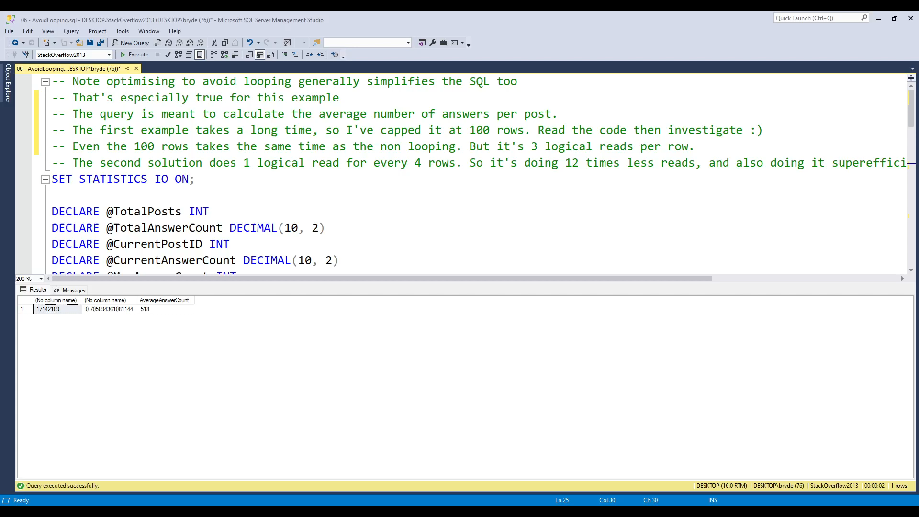

Slide 22
7. Use AND instead of OR where possible
(Or split into 2 queries and UNION the results)
Think through how an OR works, the server needs to traverse both branches of the OR, but typically just scans the whole table
UNION is the most efficient solution, but is much larger to write

Slide 23
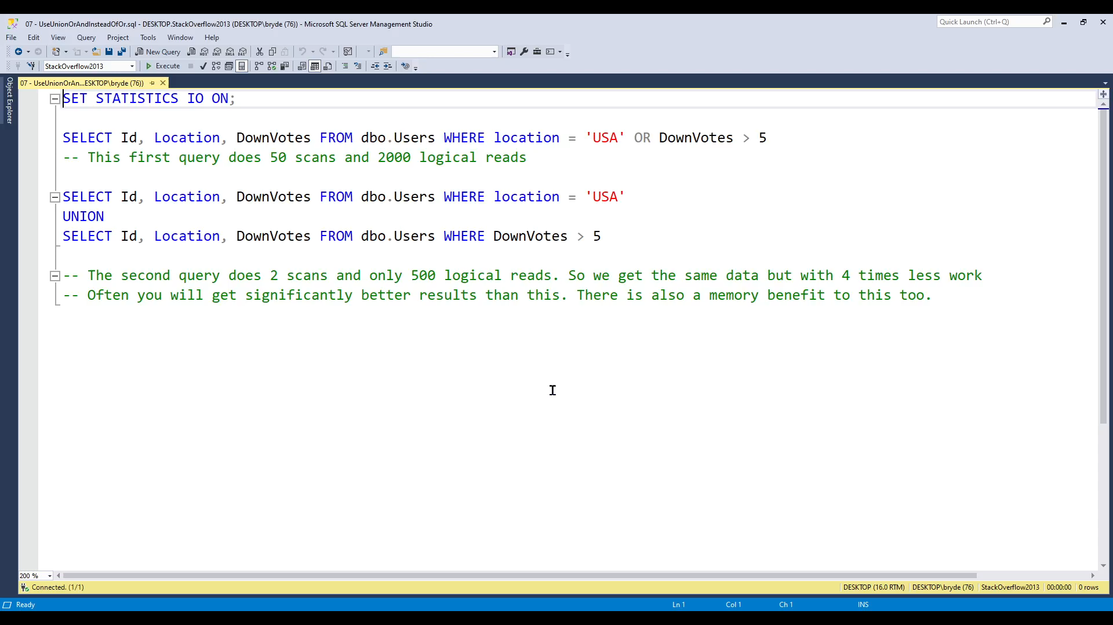

Slide 24
8. Minimize large writes
This one is often caused by the amount of locking that goes on.
Typically using Bulk Insert libraries you can avoid pain here. Be aware that the more foreign keys attached from or to your table, the worse this will get.
Indexes also have significant effect here.

Slide 25
9. Avoid wildcards at the start of string filters
i.e. don't use LIKE ‘%fred’
For EndWith, reverse the string and index on that…

Slide 26
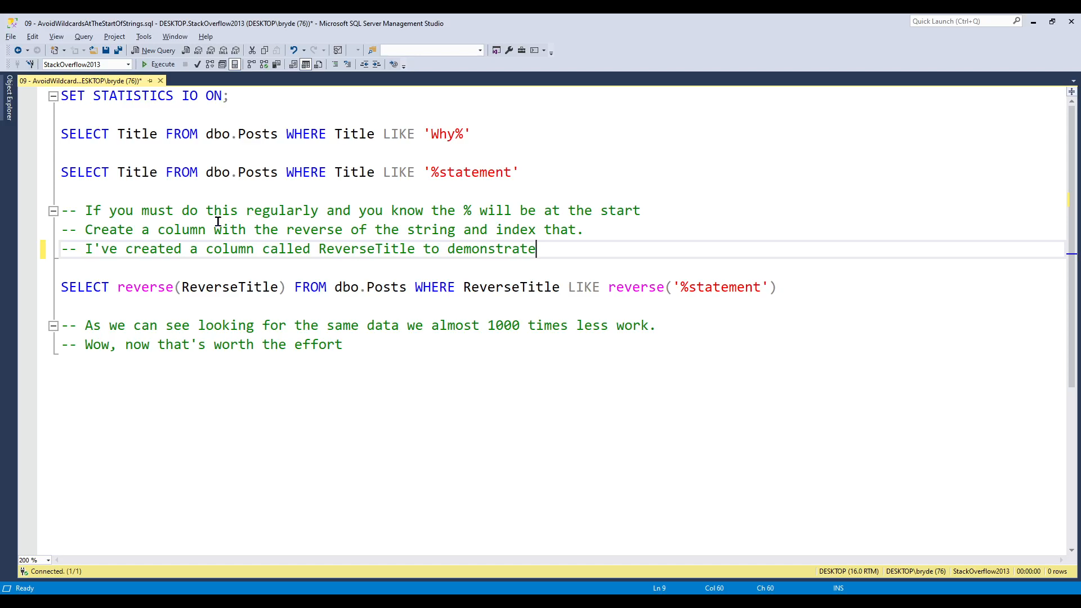

Slide 27
10. Create joins with inner joins not where
Optimizer optimizes JOINs better than WHERE
Can convert most WHERE to JOIN (but not ALL)
Easier to read
Makes it clear what type of JOIN

Slide 28
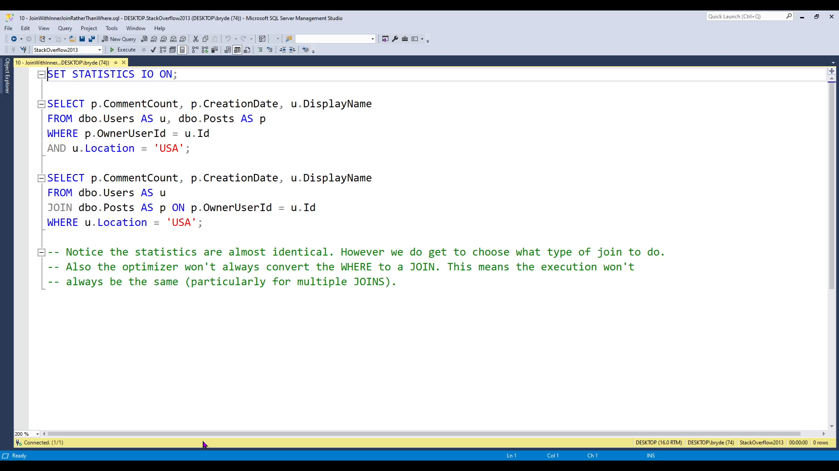

Slide 29
11. Use Exists() instead of count() where you can
Exists() stops as soon as it finds a match
Count() scans to count all the occurrences
Often people write
WHERE count() > 0
WHERE Exists()

Slide 30
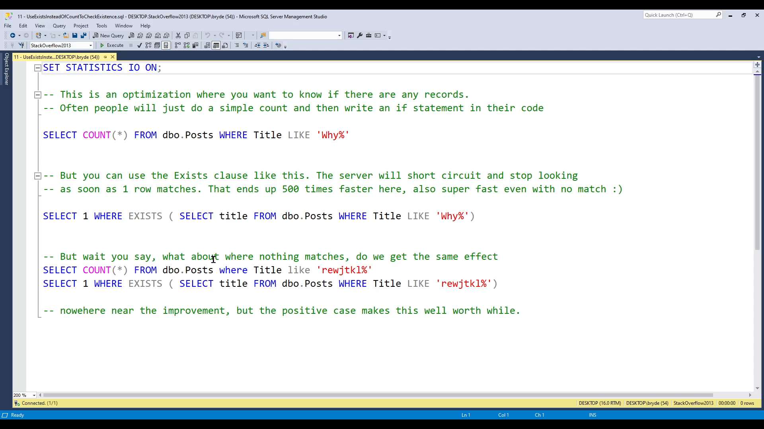

Slide 31
12. Avoid SELECT DISTINCT
Needs to sort to eliminate the duplicates
May require excessive reading
GROUP BY or more appropriate filtering are better solutions

Slide 32
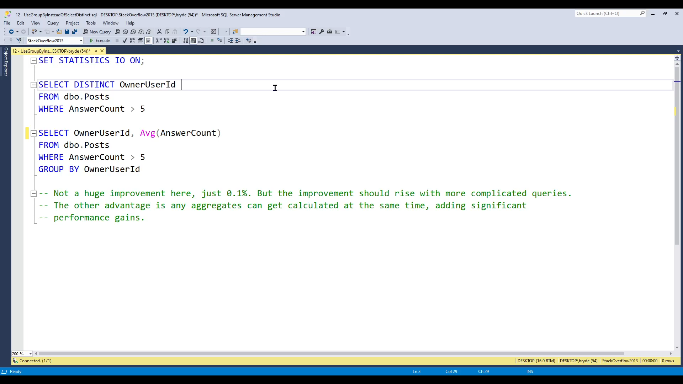

Slide 33
13. Avoid too many joins
While this one is again “it depends”
In general 4-7 JOINs is getting high
Anything more than this will result in the query optimizer struggling significantly.

Slide 34
14. Use TOP for sampling
If you just need to show a few rows as a sample or to verify data. Remember to use TOP to cap the number of rows.
Ie: SELECT TOP 100 * FROM customers

Slide 35
15. Use WHERE instead of HAVING
If you can using WHERE before aggregating is far more efficient than using HAVING after aggregation.
This is because WHERE can take advantage of an index while HAVING cannot.
But they do different things, so often you can’t.

Slide 36
Recap:
Reduce Table Size ✨
SELECT only the columns you want ✨
Create Indexes ✨
Verify your indexes are used
Avoid implicit type conversions
Avoid looping
Use AND instead of OR
Minimise large writes

Slide 37
Avoid wildcards at the start of filters
Use JOIN over WHERE
Use EXISTS instead of COUNT > 0
Avoid SELECT DISTINCT
Avoid too many JOINs
Use TOP for sampling
Use WHERE instead of HAVING

Slide 38

Resources
Brent Ozar
brentozar.com
SSW Rules
https://www.ssw.com.au/rules/rules-to-better-sql-databases-performance/
And loads more, Stack Overflow is also great!
The demo database used here (and that lots of SQL demos and courses use) is sourced from: archive.org/details/stackexchange
Brent Ozar keeps a ready to deploy SQL Server database of that, easily downloadable in various sizes for people to learn with. Thanks Brent!!!
Notes:
Tip: Resources indicates that you’re nearing the end of your presentation

Slide 39
Specific further reading
Think like the SQL Server Engine
brentozar.com/training/think-like-sql-server-engine/
Sargable Expressions
sqlshack.com/how-to-use-sargable-expressions-in-t-sql-queries-performance-advantages-and-examples/

Slide 40

Thank you!
ssw.com.au Sydney | Melbourne | Brisbane | Newcastle | Strasbourg | Hangzhou
github.com/brydeno/DatabasePerformance
Notes:
Note: You should say “thank you” and then pause for 4-5 seconds… to give the audience time to applaud!
https://www.ssw.com.au/rules/do-you-finish-your-presentation-with-a-thank-you-slide

Slide 41
Questions?
ssw.com.au Sydney | Melbourne | Brisbane | Newcastle | Strasbourg | Hangzhou
github.com/brydeno/DatabasePerformance
Notes:
Note: You should pause for applause here!
https://www.ssw.com.au/rules/do-you-finish-your-presentation-with-a-thank-you-slide

